Slide 1

TMDB MOVIE ANALYSIS
-Presented By
DEEKSHA R

Slide 2

DATA PRE-PROCESSING
First step ,the data was loaded and read into python using pandas library.
Statistically summary to know about the aggregation values
Identifying missing values
Data Imputation with the help of modal value as it is best suited for categorical data type

Slide 3
DESCRIPTION OF DATASET
The TMDB Movie dataset is a collection of information about movies.
It includes details like movie titles, release dates, genres, cast and crew, budget, revenue, and user ratings.
This dataset allows for analysis of trends in a movie success or loss.
This dataset is used for understanding the various perspectives in movies.

Slide 4
DESCRIPTION OF METHOD USED
I chose to remove the missing values as since the columns had unique values.
Filling it in with aggregation values would give biased data and not make sense.
So removing it is easier as we can avoid any wrong imputations.
There is no correlation between popularity of movies and its budget.
I feel budget is not always a good indicator of the quality of a movie.
There are many low-budget movies that are very popular, and many high-budget movies that are not.

Slide 5
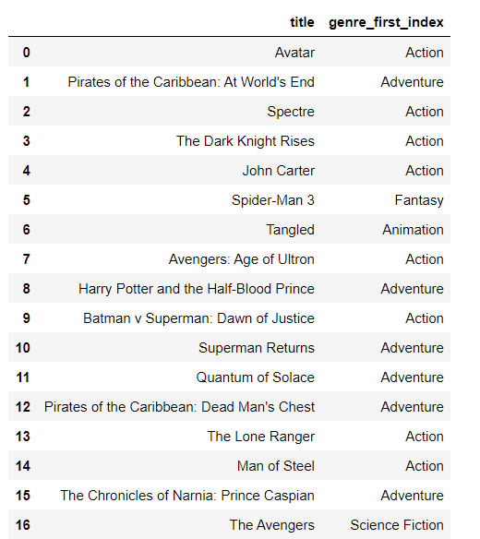
Task 1
Question:
Display the genres and title of first 50 movies
CODE:
df2[['title','genre_first_index']].head(50)

Slide 6
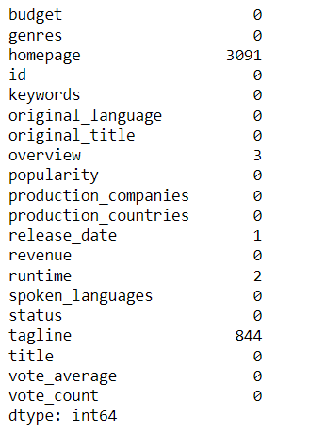
Task 2
Question:
Identify null values from the dataframe
CODE:
df1.isnull().sum()

Slide 7
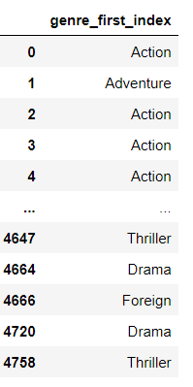
Task 3
Question:
Display movie categories that have
Budget greater than $220000
CODE:
df2[df2['budget'] > 220000][['genre_first_index']]

Slide 8
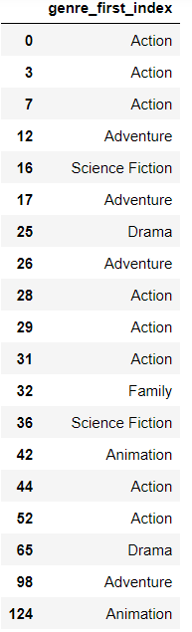
Task 4
Question:
Display movie categories that have revenue greater than $961,000,000
CODE:
df2[df2['revenue'] > 961000000][['genre_first_index']]

Slide 9
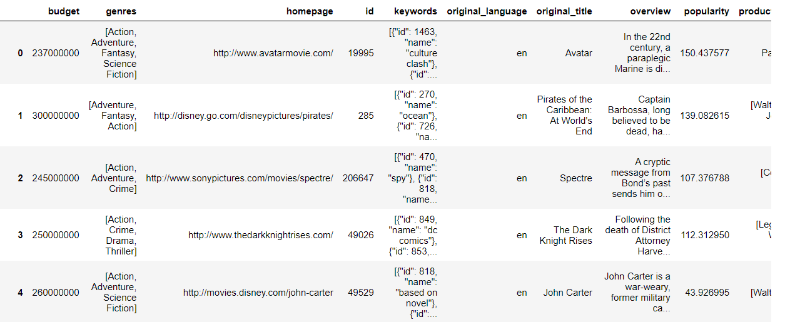
Task 5
Question:
Remove rows with values 0 from budget and revenue columns
CODE:
df1=df1[(df1['budget'] != 0) & (df1['revenue']!= 0)]
df1

Slide 10
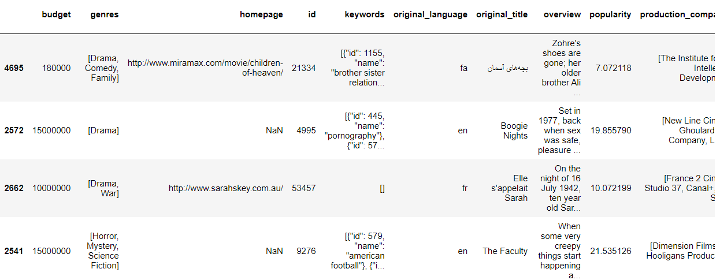
Task 6
Question:
List top 10 movies with highest revenue and top 10 with least budget
CODE:
df2.sort_values(by='revenue',ascending=False).head(10)
df2.sort_values(by='budget',ascending=False).head(10)

Slide 11
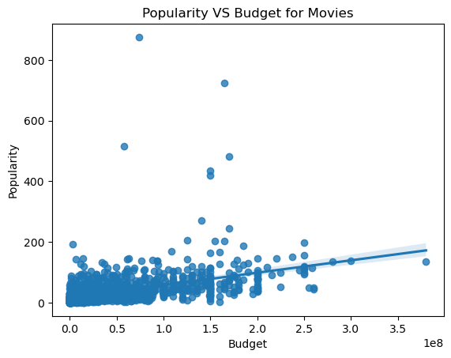
Task 7
Question:
How are popularity of movies related to movie budgets?
CODE:
sb.regplot(x= "budget",
y = "popularity",
data = df1)
plt.xlabel('Budget')
plt.ylabel('Popularity')
plt.title('Popularity VS Budget for Movies')
plt.show()

Slide 12
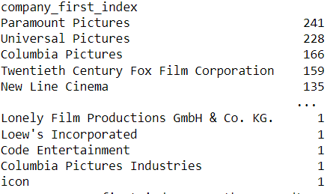
Task 8
Question:
Display the names of production companies along with the number of times they appear in dataset
CODE:
df2.groupby('company_first_index')['company_first_index'].count().sort_values(ascending=False)

Slide 13
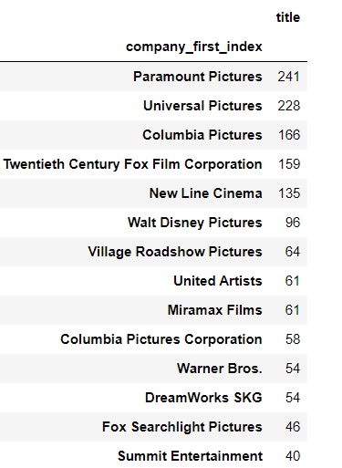
Task 9
Question:
Display the names of top 25 production companies based on no.of movies produced in descending order of no.of movies produced
CODE:
pd.pivot_table(data=df2,index='company_first_index',values='title',aggfunc='count').sort_values(by=['title'], ascending=False).head(25)

Slide 14
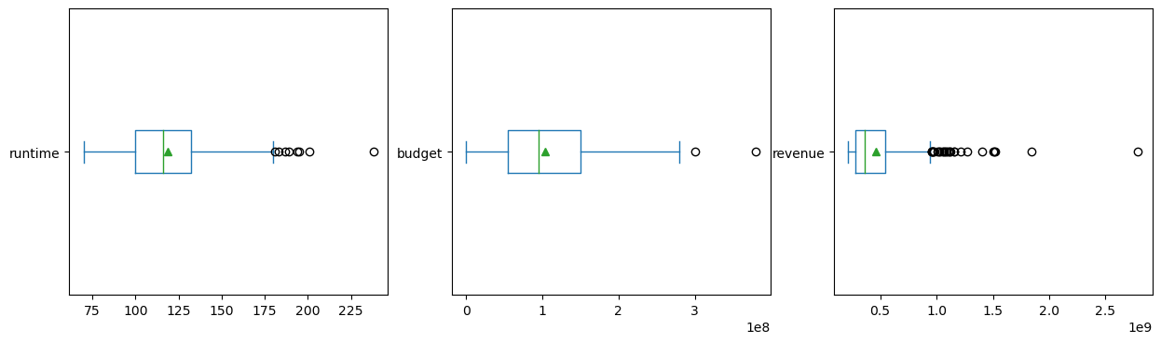
Task 10
Question:
Sort the data in desc order based on revenue and filter top 500 movies and perform aggregations for budget, runtime,revenue column and do outlier analysis
CODE:
df2 = df2.sort_values(by='revenue', ascending=False) top_500 = df2.head(500)

Slide 15
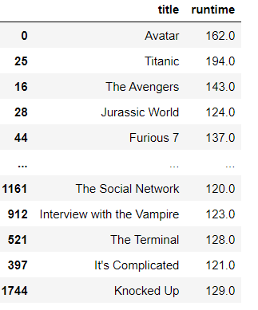
Task 11
Question:
Display the names of the movies along with runtimes for those movies that have above avg runtime.
CODE:
above_avg_movies = df[df['runtime'] > avg_runtime]
production_counts = above_avg_movies[['title','runtime']]
production_counts

